Slide 1

VGA Driver
Nikolaos Karapoulatidis, Shehroz Bashir Malik, Christian Stratmann

Slide 2
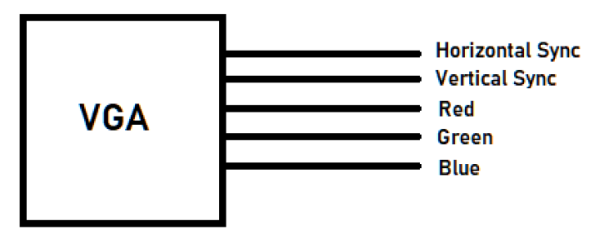
VGA Signals

Slide 3
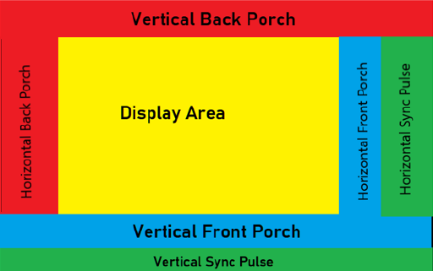
Concept Design

Slide 4
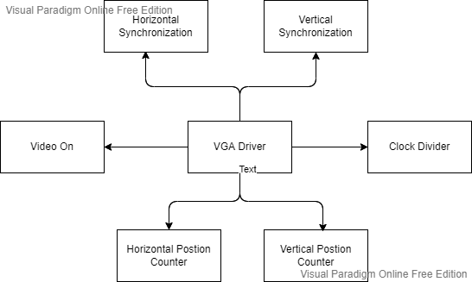
Block Diagram

Slide 5
Entity
Input: Clock and reset with type STD_logic
Output: Horizontal Sync and Vertical Sync with type STD_logic, Red Green Blue with STD_Logic_Vector

Slide 6
Architecture
Signals: Clock25, Horizontal Position, Vertical Position and VideoOn
Constants for Horizontal (pixel number): Display, front porch, back porch, sync pulse/retrace
Constants for Vertical (line number): Display, upper porch, lower porch, sync pulse/retrace

Slide 7
Processes I
Every process depends on the rising edge of the clock
Clock Divider: creates a clock of 25 mHz (default is 50mHz)
Horizontal Position Counter: horizontal position = the total horizontal pixels? If true then start from left side, if not then counter++ and head to the next pixel
Vertical Position Counter: If true when start from the top

Slide 8
Processes II
Horizontal Synchronization: checks if the actual horizontal position is inside the horizontal front porch or back porch. If true then HSYNC set to 1
Vertical Synchronization: checks for upper and lower porch
Video On Check: ensures that the video is only on when the actual position is not inside a porch

Slide 9
Processes III
Draw Box: set the output RGB to 111 if we are between 10 and 60 for the horizontal position and vertical position, outside those boundaries RGB is set to 000
-> white square appears on the VGA monitor

Slide 10

Testbench
testbench is toggling the clock every 5ns and the reset every 100ns

Slide 11
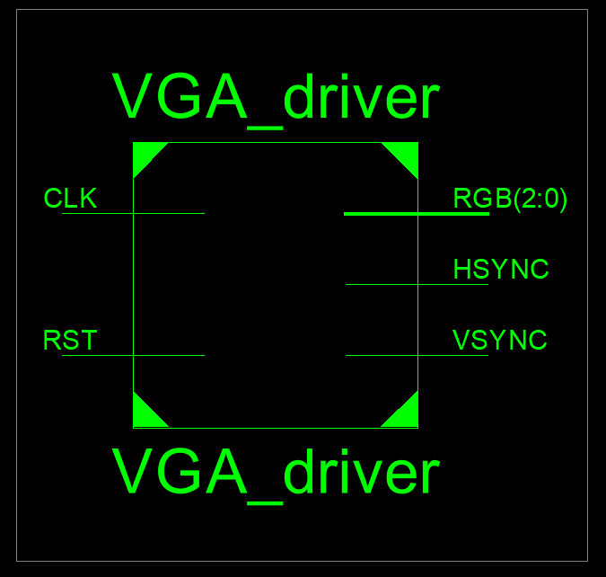
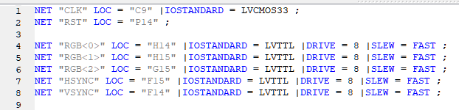
RTL Schematic I

Slide 12
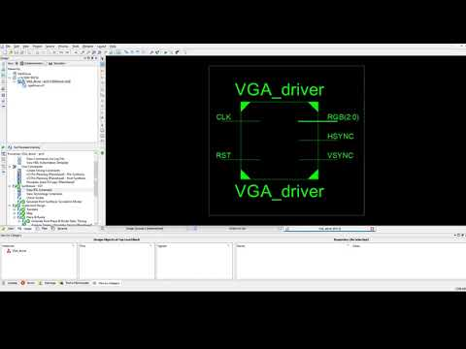
RTL Schematic II

Slide 13
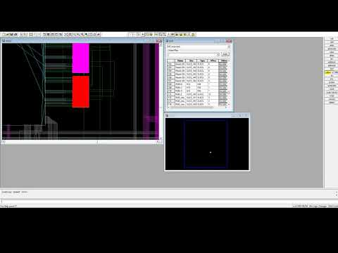
Routed Design

Slide 14
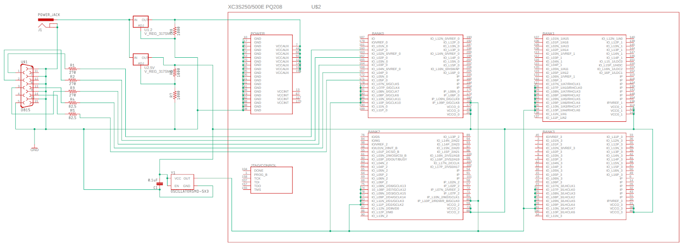
PCB schematic
Spartan 3E from Xilinx
Two 317 voltage regulators (2.5 and 1.2 volts)
Oscillator is providing a 25 MHz clock signal

Slide 15
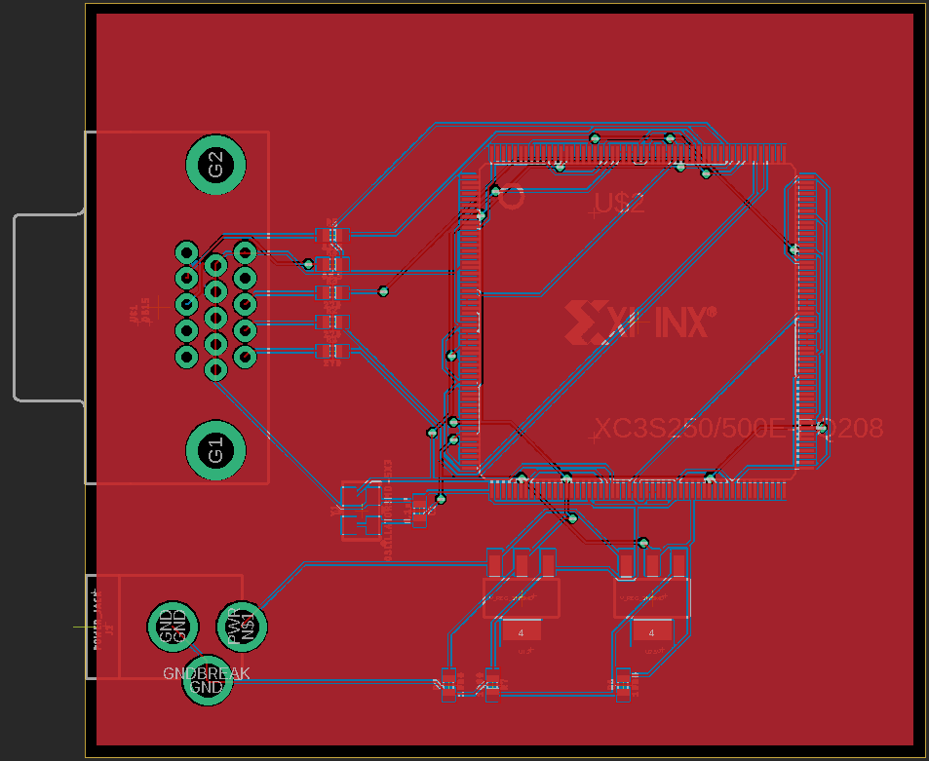
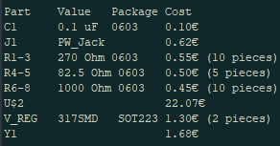
PCB layout
Width: 80.1 mm
Length: 67.5 mm
Total cost for the components: €27.27
PCB: ~€4.74 (with shipping ~€25)

Slide 16
Conclusion
PCB Schematic explored
Ready for FPGA Implementation
VGA Concepts examined
Succesfully implemented in VHDL

